Slide 1
Session Id Fixation
Smayan Daruka

Slide 2

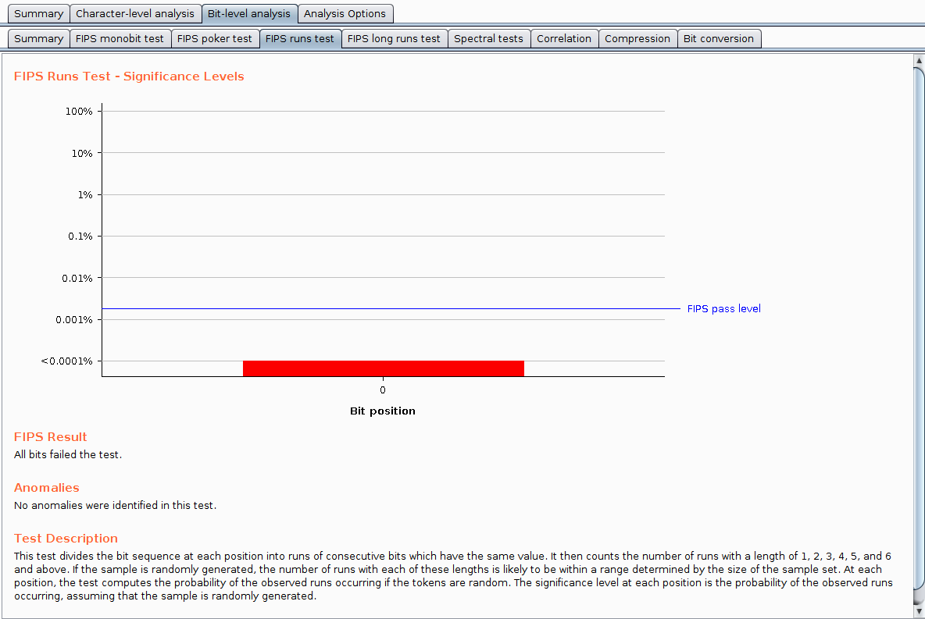
Underlying Problem
As we can see on the right, the current implementation of armbook fails all FIPS tests.
Analysis revealed that the effective entropy of bits is 0.
It is fairly easy to ascertain session IDs and steal users’ sessions.

Slide 3
SOLUTIONS
One of the ways to fix this issue is to change how sessions are being generated after line 20 in login.php
Currently, sessions can be set using a GET request which is another security vulnerability.
Also change line 82 in index.php such that the session IDs being generated are a function of time to increase overall security.
It is also a good idea to use longer keys / session IDs so they are harder to brute force, thus making them more secure.

